Slide 1
Looping
Mr Mack 2021

Slide 2
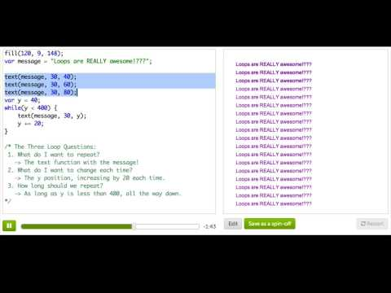
Intro to While Loops

Slide 3
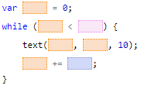
Practice: A Loopy Ruler
See how we repeat the text command multiple times, to draw ruler marks for the x coordinates along the top? You'll replace that with a while loop that does the exact same thing!
Remember to think about:
1) What do you want to repeat each time?
2) What value do you want to change each time?
3) When do you want to stop looping?
Tip: Be careful with the condition you use for your while loop, and make sure you increment your variable correctly - otherwise your while loop will get stuck running forever.
Loop it!

Slide 4
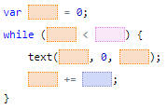
Practice: A Loopy Ruler
Now let's do the same for y, so that we have a ruler going down the left side of our canvas too! It should be very similar to the loop you have for the x.
A loop for the side, too

Slide 5
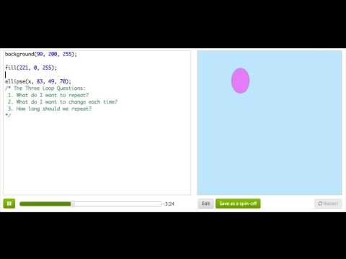
More While Loops: Balloon Hopper

Slide 6

Practice: A Loopy Landscape
In this challenge, you'll use your knowledge about while loops to fill the canvas with a beautiful landscape. As a first step, make a new variable and use it for the x position of the tree and grass images.
Use a variable for the x position

Slide 7
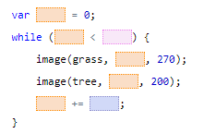
Practice: A Loopy Landscape
You're ready to create your landscape. Use a while loop to draw grass and trees across the canvas, from left to right:
- Start off by making a while loop that draws the tree and the grass;
- Make sure your variable starts close to the left edge of the canvas;
- Increment the variable, so that each tree and grass patch is drawn close to the last;
- It should keep drawing while the x position variable is inside the canvas;
Tip: Be careful with the condition of your while loop, and make sure you increment the variable properly inside it. Otherwise, your while loop will run forever and ever and ever...
Use a while loop to change the x position

Slide 8
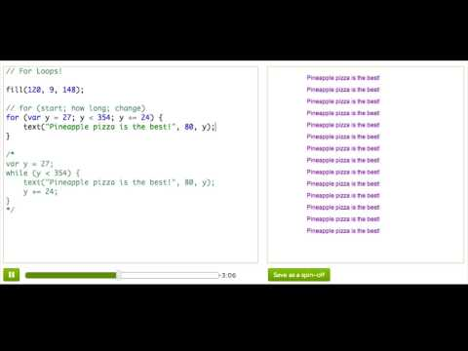
For Loops! A New Kind of Loop

Slide 9

Practice: Lined Paper
We used a while loop that draws 20 evenly spaced horizontal lines (lines that go from left to right) to draw lined paper.
We want you to convert the while loop to a for loop.
You may find it easier to complete this step if you comment out the provided while loop and use it as a guide to create your for loop.
Convert it to a for loop

Slide 10

Practice: Lined Paper
Now, add a for loop that draws 20 evenly spaced vertical lines (lines that go from top to bottom) to turn the lined paper into grid paper. The first vertical line should have an x coordinate of 20, and the last vertical line should have an x coordinate of 400.
Make it graph paper

Slide 11
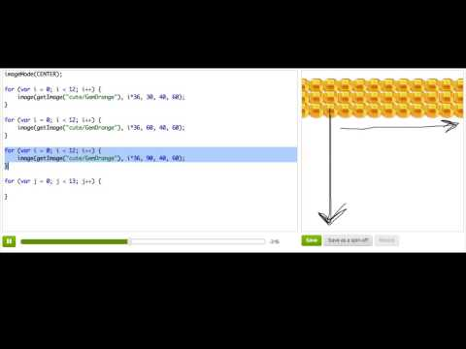
Nested For Loops

Slide 12
Review: Looping
When we're writing programs, we often find that we want to repeat a bit of code over and over, or repeat it but change something about it each time. To save ourselves from writing all that code, we can use a loop. JavaScript has two kinds of loops, a while loop and a for loop.
A while loop is a way to repeat code until some condition is false. For example, this while loop will display the value of y at (30, y) as long as y is less than 400. The loop adds 20 to y each time it runs, so that y starts off at 40 but then increments to 60, 80, 100, 120, etc.

Slide 13
Review: Looping
var y = 40;
while (y < 400) {
text(y, 30, y);
y += 20;
}
It's important that the condition inside the parenthesis becomes false at some point - otherwise we'll have what's known as an infinite loop! That's what would happen if we removed y += 20, because y would be 40 forever, and always be less than 400, and the program would never know when to stop.
var y = 40;
while (y < 400) {
text(y, 30, y);
}

Slide 14
Review: Looping
The for loop is similar to a while loop, but with a more specialized syntax. Programmers invented the for loop when they realized they were always doing the same three things- creating loop counter variables (like y above), incrementing them by some amount, and checking that they're less than a value. A for loop syntax has special places for each of those three things. Here's the same loop as the first while loop above, as a for loop:
for (var y = 40; y < 400; y += 20) {
text(y, 30, y);
}

Slide 15
Review: Looping
Loops can also be nested. It's actually very common to nest for loops, especially in 2-d drawings, because it makes it easy to draw grid-like shapes. When we nest a loop inside a loop, we're telling the program to "do this thing X many times, and for each time you do that, also do this other thing Y many times." Think about drawing a grid- we'd want to tell the program to "create a column 10 times, and for each column, also create 15 cells inside of it." Here's how you can use nested for loops to achieve that:
for (var col = 0; col < 10; col++) {
for (var row = 0; row < 15; row++) {
rect(col*20, row*20, 20, 20);
}
}

Slide 16
Challenge: Build-a-House
Think about your house, apartment, school, or office building. There's a lot of repeating elements - especially on the outside. In this project, you'll use loops to add repeating elements to this house. Suggested steps:
Draw a window, then use a for loop to draw a row of windows (or, use nested for loops to make multiple rows of windows).
Draw a row of grass in front. And maybe some bushes or flowers?
The house is a plain color now. Use loops to make it a brick house or a house with "siding" or a log cabin. Check the images library for ways to make that more realistic.
Bonus: Use a conditional inside a for loop to make more interesting grass or walls, using a different color for every other iteration of the loop (hint: use the % operator).
Keep going! What else could you draw with loops?

